Slide 1
Spotify Top 50 Songs in World Dashboard
Power Bi Project

Slide 2
Abstract
This project analyzes Spotify Top 50 songs from world and this data to understand music trends, artist popularity, and song characteristics using Power BI dashboards.

Slide 3
Objective
Analyze song popularity
Identify top artists and songs
Understand trends by year and album type
Visualize insights interactively

Slide 4
Dashboard Overview
KPI Cards (Songs, Artists, Popularity)
Popular Artists chart
Popular Songs chart
Album type distribution
Monthly trends

Slide 5
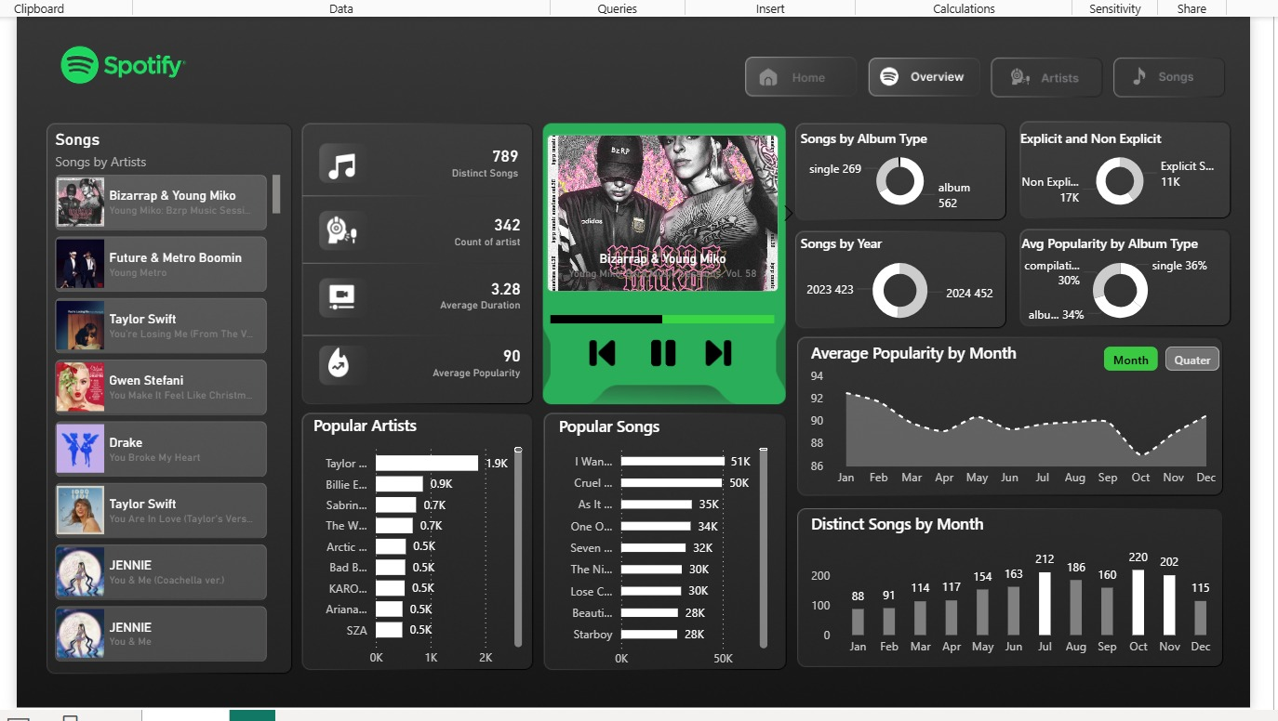
Dashboard

Slide 6
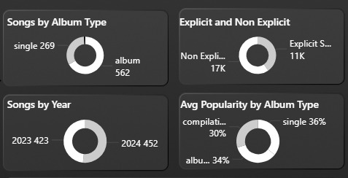
Donut Chart
1st Donut chart will explain single or album songs from the Spotify.
2nd Donut chart will explain explicit and non explicit songs from the Spotify.
3rd Donut chart will explain songs from 2023 and 2024 years in Spotify.
4th Donut chart will explain Average popularity by songs from Spotify.

Slide 7
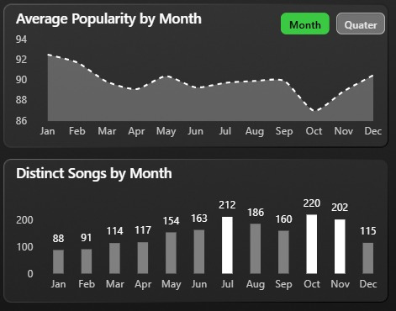
Popular Songs and Artists
The Spotify Top 50 World shows that song popularity is mostly steady,
but it drops a little in October and rises again by December.
The number of different songs is highest in October and lowest in the beginning of the year. Overall, more variety of songs appears in the middle and end of the year.

Slide 8
Conclusion
The dashboard provides clear insights into Spotify trends, helping understand user preferences and music patterns.

Slide 9


